Slide 1

Testing in NodeJS
Day 7

Slide 2
What testing means?
In tech jargon testing means checking that our code meets some expectations. For example: a function called "transformer" should returns the expected output given some input.
There are many types of testing and soon you'll be overwhelmed by the terminology, but long story short tests fall into three main categories:
unit testing
integration testing
UI testing
In this session we'll cover only unit testing, but at the end of the article you'll find resources for the other types of tests.
Automated testing or test automation is a method in software testing that makes use of special software tools to control the execution of tests and then compares actual test results with predicted or expected results. All of this is done automatically with little or no intervention from the test engineer.

Slide 3
Unit testing
UNIT TESTING is a level of software testing where individual units/ components of a software are tested. The purpose is to validate that each unit of the software performs as designed. A unit is the smallest testable part of any software.
Benefits of unit testing
Refactoring. Change code once, and see everything else is working.
Helps understand design of code working with
Instant visual feedback that code works as expected.
Helps with code-reuse. Ability to re-use code and tests. Tweak tests accordingly.
Testable code
Modular
Maintainable
Readable

Slide 4
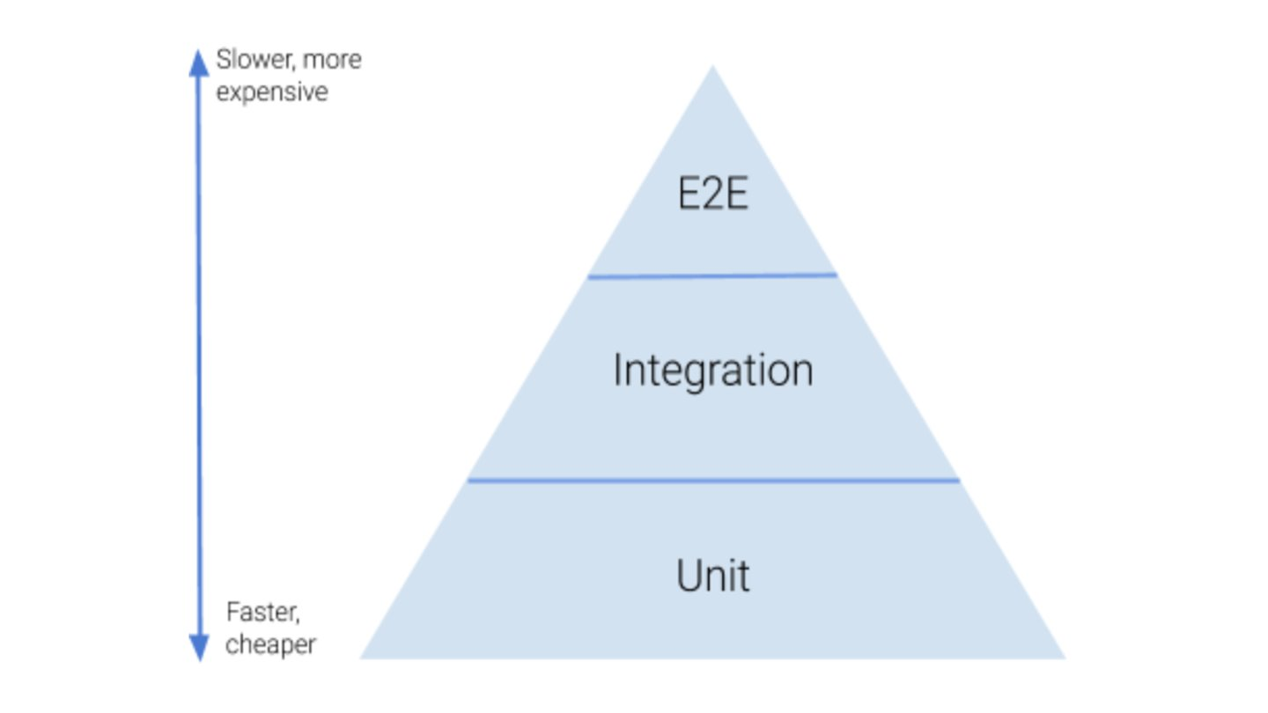

Slide 5
Test driven development
Start by writing a test.
Run the test, and any other tests. At this point, your newly added test should fail. If it doesn’t fail here, it might not be testing the right thing, and has a bug in it.
Write the minimum amount of code required to make the test pass.
Run the test to check the new test passes.
Optionally refactor your code.
Repeat step #1.

Slide 6
Testing frameworks
Jasmine
Mocha
a. Chai
b. Sinon
JEST

Slide 7
Jest
An open source framework that built for test ReactJS and JavaScript.
Created and maintained by the Facebook. It was built with multiple layers on top of jasmine(open source testing framework) by keeping some of good parts from jasmine.
Human friendly framework. It has gained its attraction by its well supported and very fast testing behavior.
npm install jest –save-dev

Slide 8
Benefits of jest testing
Fast framework
Simple configuration
Easy to use
Snapshot testing
In-built Mocks and spies
In-built Coverage reports
Comes with an assertion library
Runs tests in parallel processes
Promise support
Open source
Comes with wide APIs

Slide 9
Let's start write test cases
Make sure you have JEST installed
$ npm install jest --save-dev
Or if you're using yarn
$ yarn add jest --dev
In the root application folder, create a new folder named tests
In the tests folder, create two other folders named integration and unit
Package.json
In the scripts section of your package.json file, add:
“test-dev”: “npm test”
Or
“test-dev”: “jest”

Slide 10
Unit Testing
Let's say that in your application you have this controllers/forgotPasswordController.js file:
export const forgotPassword = () => {
return true;
}
And you need to make sure that the forgotPassword() function always returns true
In the tests/unit folder, create a file named forgot_password.spec.js with the content below. It's pretty self-explanatory
import { forgotPassword } from "../../controllers/forgotPasswordController";
describe("forgotPassword()", () => {
it("should return true", () => {
//Testing a boolean
expect(forgotPassword()).toBeTruthy();
//Another way to test a boolean
expect(forgotPassword()).toEqual(true);
});
});
Go to your terminal, then run:
$ npm run test-dev

Slide 11
Integration testing
Testing your application gets even more interesting when it comes to integration tests. We're going to add a dependency to the forgotPasswordController.
export const doSomethingBefore = () => {
return false;
};
export const forgotPassword = (data) => {
const boolean = doSomethingBefore();
if(!boolean) {
return true;
}
return false;
};

Slide 12
And then, in the forgot_password.spec.js file
import { doSomethingBefore, forgotPassword } from "../../controllers/auth/controller";
describe("forgotPassword()", () => {
it("should do something before the forgotPassword function gets called", () => {
expect(doSomethingBefore()).toBeFalsy();
});
//Then
it("forgotPassword should return true", () => {
expect(forgotPassword()).toBeTruthy();
});
});

Slide 13
Testing API endpoints
Just out of curiosity, you can also run integration tests consuming the API endpoints of your application with supertest and then checking if the response body is what you were expecting e.g.
In the tests folder create another folder named helpers
In the helpers folder, create a file named helpers.js with the following content
const supertest = require("supertest");
const app = require("../../app/main/app");
class Helper {
constructor(model) {
this.apiServer = supertest(app);
}
}
module.exports = Helper;

Slide 14
Then, the forgot_password.spec.js file should look like this:
const Helper = require("../helpers/forgot_password.helper");
const helper = new Helper();
const urlPrefix = "/v1/auth";
describe("Forgot password endpoints", () => {
it("Consuming API endpoint", async () => {
const { body } = await helper.apiServer
.post(`${urlPrefix}/forgot-password`, {
email: "email@mailinator.com"
})
expect(body).toHaveProperty("reset_token");
expect(body).toHaveProperty("email");
});
});

Slide 15
What are Mocks?
In unit testing, mocks provide us with the capability to stub the functionality provided by a dependency and a means to observe how our code interacts with the dependency. Mocks are especially useful when it's expensive or impractical to include a dependency directly into our tests, for example, in cases where your code is making HTTP calls to an API or interacting with the database layer.
It is preferable to stub out the responses for these dependencies, while making sure that they are called as required. This is where mocks come in handy.
Let us now see how we can use Jest to create mocks in Node.js.

Slide 16
In this tutorial, we will set up a Node.js app that will make HTTP calls to a JSON API containing photos in an album. Jest will be used to mock the API calls in our tests.
First, let's create the directory under which our files will reside and move into it:
$ mkdir PhotoAlbumJest && cd PhotoAlbumJest
Then, let's initialize the Node project with the default settings:
$ npm init -y
Once the project is initialized, we will then proceed to create an index.js file at the root of the directory:
$ touch index.js

Slide 17
Setting up Axios
We will be using axios as our HTTP client. Axios is a lightweight, promise-based HTTP client for Node.js which can also be used by web browsers. This makes it a good fit for our use case.
Let's first install it:
$ npm i axios --save
Before using axios, we'll create a file called axiosConfig.js through which we'll configure the Axios client. Configuring the client allows us to use common settings across a set of HTTP requests.
For example, we can set authorization headers for a set of HTTP requests, or most commonly, a base URL which will be used for all HTTP requests.
Let's create the configuration file:
touch axiosConfig.js

Slide 18
Using Axios
const axios = require('axios'); const axiosInstance = axios.default.create({ baseURL: 'https://jsonplaceholder.typicode.com/albums' }); module.exports = axiosInstance;
After setting the baseURL, we've exported the axios instance so that we can use it across our application. We'll be using www.jsonplaceholder.typicode.com which is a fake online REST API for testing and prototyping.
In the index.js file we created earlier, let's define a function that returns a list of photo URLs given an album's ID:
const axios = require('./axiosConfig'); const getPhotosByAlbumId = async (id) => { const result = await axios.request({ method: 'get', url: `/${id}/photos?_limit=3` }); const { data } = result; return data; }; module.exports = getPhotosByAlbumId;
To hit our API we simply use the axios.request() method of our axios instance. We pass in the name of the method, which in our case is a get and the url which we will invoke.
The string we pass to the url field will be concatenated to the baseURL from axiosConfig.js.
Now, let's set up a Jest test for this function.

Slide 19
Setup Jest
To set up Jest, we must first install Jest as a development dependency using npm:
$ npm i jest -D
The -D flag is a shortcut for --save-dev, which tells NPM to save it as a development dependency.
We will then proceed to create a configuration file for Jest called jest.config.js:
touch jest.config.js
Now, in the jest.config.js file, we'll set the directories in which our tests will reside:
module.exports = { testMatch: [ '<rootDir>/**/__tests__/**/?(*.)(spec|test).js', '<rootDir>/**/?(*.)(spec|test).js' ], testEnvironment: 'node', };

Slide 20
Mocking an HTTP Call With Jest
const axios = require('./axiosConfig');
const getPhotosByAlbumId = require('./index');
jest.mock('./axiosConfig', () => {
return {
baseURL: 'https://jsonplaceholder.typicode.com/albums',
request: jest.fn().mockResolvedValue({
data: [
{
albumId: 3,
id: 101,
title: 'incidunt alias vel enim',
url: 'https://via.placeholder.com/600/e743b',
thumbnailUrl: 'https://via.placeholder.com/150/e743b'
},
{
albumId: 3,
id: 102,
title: 'eaque iste corporis tempora vero distinctio consequuntur nisi nesciunt',
url: 'https://via.placeholder.com/600/a393af',
thumbnailUrl: 'https://via.placeholder.com/150/a393af'
},
{
albumId: 3,
id: 103,
title: 'et eius nisi in ut reprehenderit labore eum',
url: 'https://via.placeholder.com/600/35cedf',
thumbnailUrl: 'https://via.placeholder.com/150/35cedf'
}
]
}),
}
});
In the index.spec.js file, we'll start fresh, deleting the old code and writing a new script that'll mock an HTTP call:

Slide 21
Here, we first import our dependencies using the require syntax. Since we do not want to make any actual network calls, we create a manual mock of our axiosConfig using the jest.mock() method. The jest.mock() method takes the module path as an argument and an optional implementation of the module as a factory parameter.
For the factory parameter, we specify that our mock, axiosConfig, should return an object consisting of baseURL and request(). The baseUrl is set to the base URL of the API. The request() is a mock function that returns an array of photos.
The request() function we've defined here replaces the real axios.request() function. When we call the request() method, our mock method will be called instead.
What's important to note is the jest.fn() function. It returns a new mock function, and its implementation is defined within the parentheses. What we've done via the mockResolvedValue() function is provide a new implementation for the request() function.
Typically, this is done via the mockImplementation() function, though since we're really only just returning the data which holds our results - we can use the sugar function instead.
mockResolvedValue() is the same as mockImplementation(() => Promise.resolve(value)).
With a mock in place, let's go ahead and write a test:
describe('test getPhotosByAlbumId', () => { afterEach(() => jest.resetAllMocks()); it('fetches photos by album id', async () => { const photos = await getPhotosByAlbumId(3); expect(axios.request).toHaveBeenCalled(); expect(axios.request).toHaveBeenCalledWith({ method: 'get', url: '/3/photos?_limit=3' }); expect(photos.length).toEqual(3); expect(photos[0].albumId).toEqual(3) }); });

Slide 22
Run Test
After each test case, we ensure that the jest.resetAllMocks() function is called to reset the state of all mocks.
In our test case, we call the getPhotosByAlbumId() function with an ID of 3 as the argument. We then make our assertions.
The first assertion expects that the axios.request() method was called, while the second assertion checks that the method was called with the correct parameters. We also check that the length of the returned array is 3 and that the first object of the array has an albumId of 3.
Let's run our new tests with:
npm test

Slide 23
Sinon Mocks vs Jest Mocks
Sinon.js and Jest have different ways they approach the concept of mocking. The following are some of the key differences to note:
In Jest, Node.js modules are automatically mocked in your tests when you place the mock files in a __mocks__ folder that's next to the node_modules folder. For example, if you a file called __mock__/fs.js, then every time the fs module is called in your test, Jest will automatically use the mocks. On the other hand, with Sinon.js you must mock each dependency manually using the sinon.mock() method on each test that needs it.
In Jest, we use the jest.fn().mockImplementation() method to replace a mocked function's implementation with a stubbed response. A good example of this can be found in the Jest documentation here. In Sinon.js, we use the mock.expects() method to handle that.
Jest provides a large number of methods for working with their mock API and particularly with modules. You can view all of them here. Sinon.js, on the other hand, has fewer methods to work with mocks and exposes a generally simpler API.
Sinon.js mocks ship as part of the Sinon.js library which can be plugged in and used in combination with other testing frameworks like Mocha and assertion libraries like Chai. Jest mocks, on the other hand, ship as part of the Jest framework, which also ships with its own assertions API.
Sinon.js mocks are often most beneficial when you're testing a small application that may not require the entire power of a framework like Jest. It's also useful when you already have a test setup and need to add mocking to a few components in your application.
However, when working with large applications that have many dependencies, leveraging on the power of Jest's mock API alongside its framework can be greatly beneficial to ensure a consistent testing experience.

Slide 24
References
https://javascript.plainenglish.io/unit-testing-node-js-mongoose-using-jest-106a39b8393d
https://jestjs.io/docs/mongodb : For Mongo DB testing
https://jestjs.io/docs : JEST tutorial in details

